Slide 1
2024-07-04_S26-S27-S28-S29
S2x_Icell_t1800_C0010_J01
Gottfrid Olsson

Slide 2
Goals with this session
Investigate if a larger Li (12 mm diameter) and/or ‘polished’ Li leads to more uniform deposition
Take a look at Josef’s 1mm Li sample

Slide 3
I’ll use 10kV3.0nA
SED multiplier: 1571 V
Contrast 15%
Brightness 73%, 52%

Slide 4
S26_Icell_t1800_C0010_J01_12mmLi

Slide 5
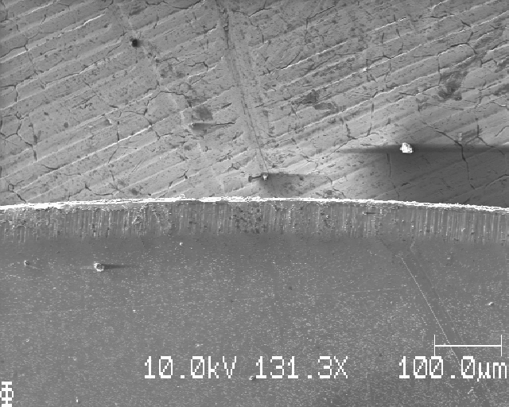
S26: top edge, moving down dy=1mm

Slide 6
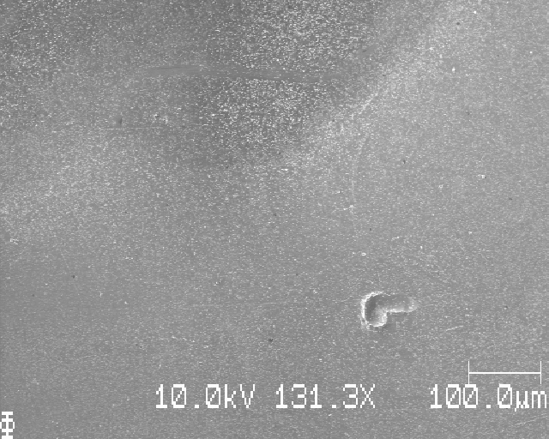
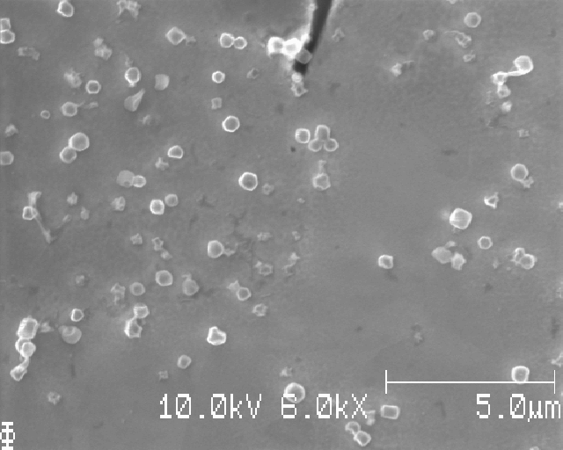
S26:

Slide 7
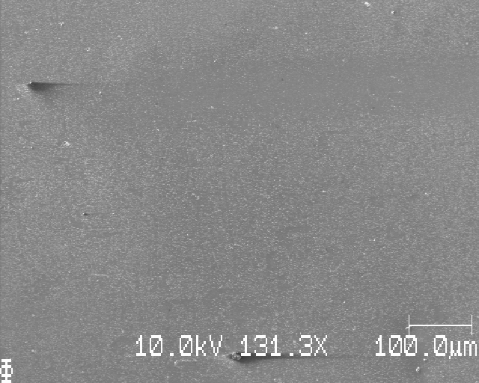
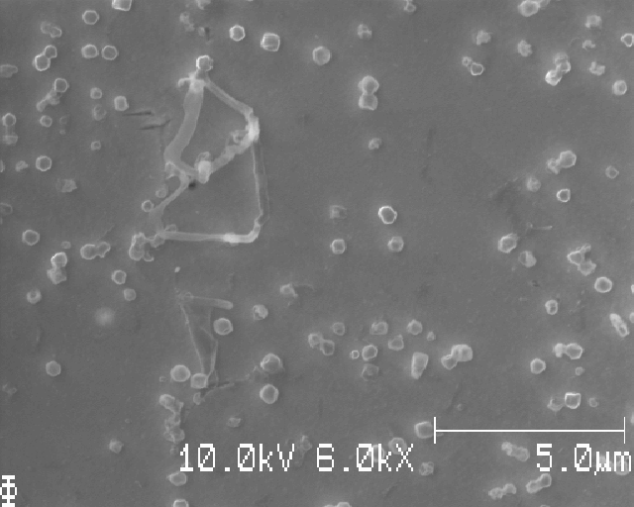
S26:

Slide 8
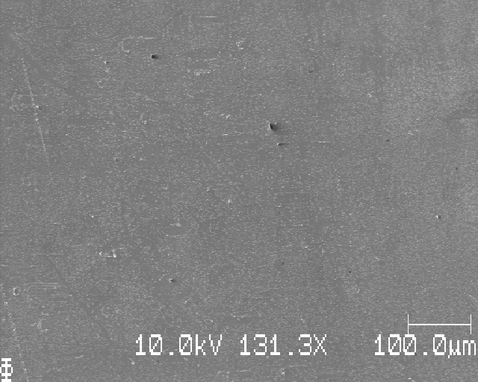
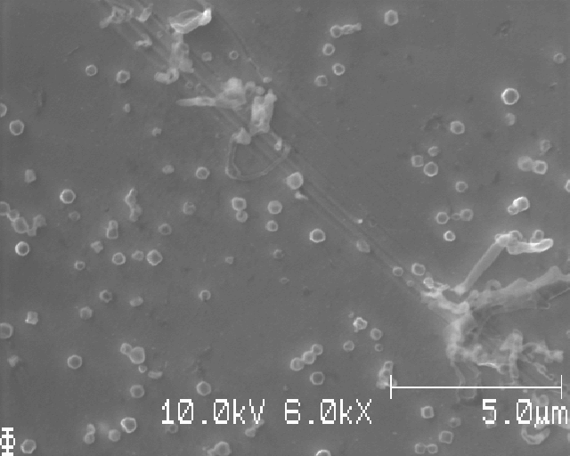
S26:

Slide 9
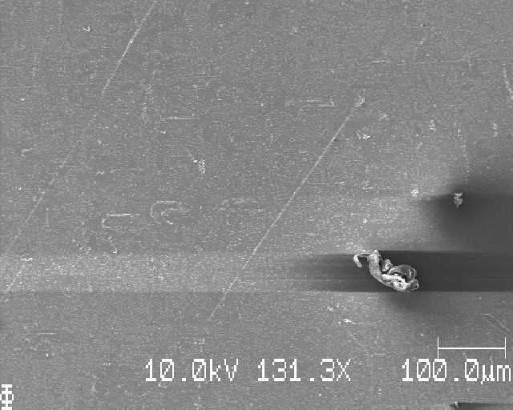
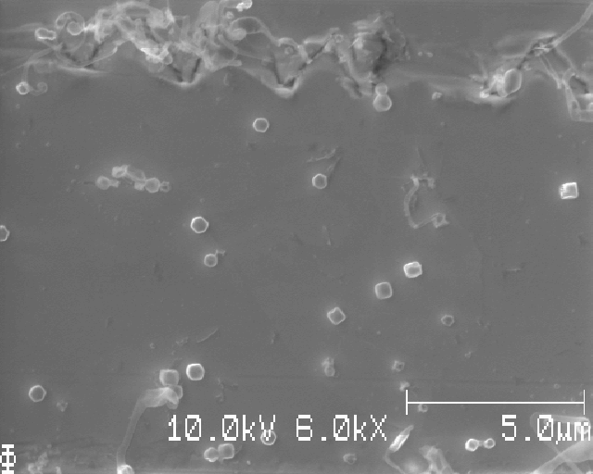
S26:

Slide 10
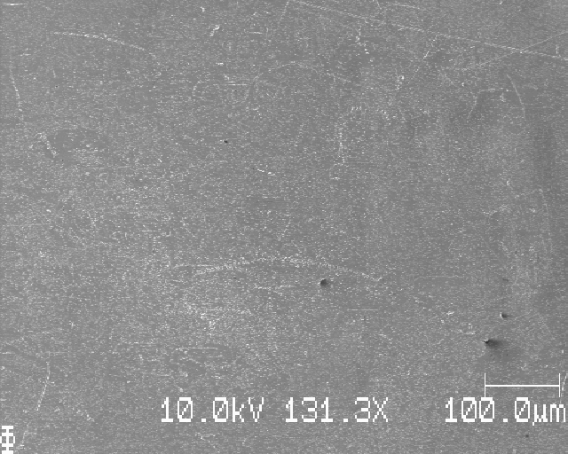
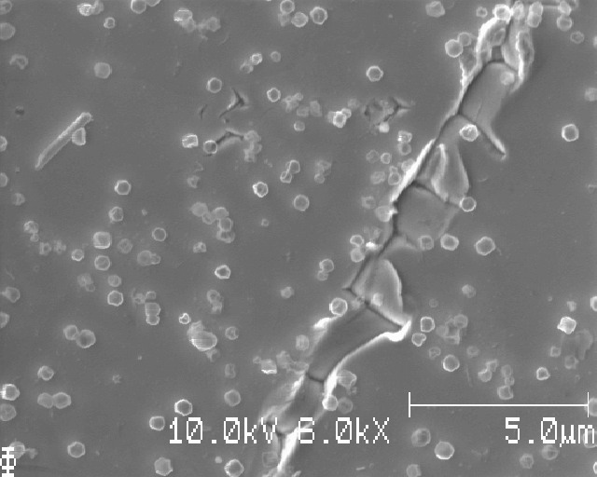
S26:

Slide 11
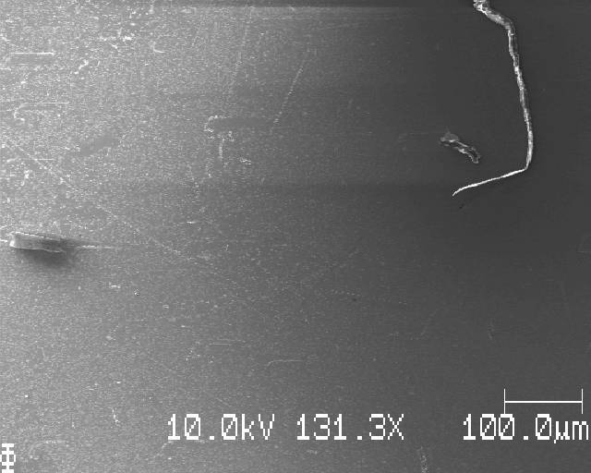
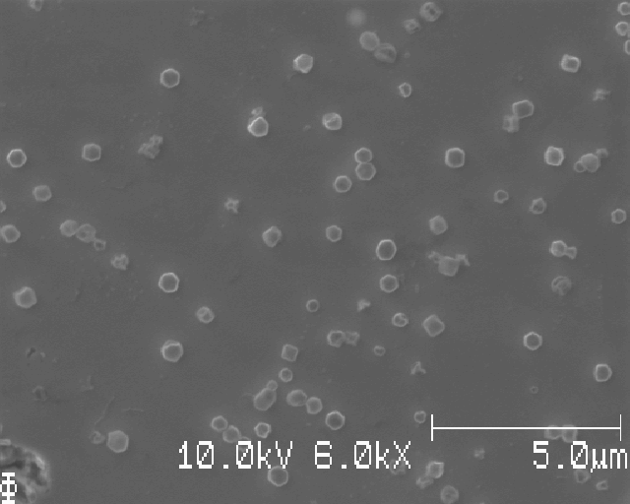
S26:

Slide 12
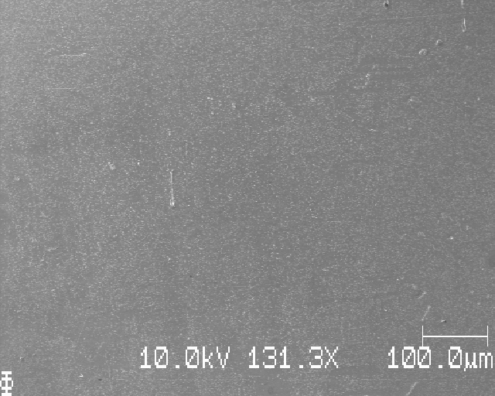
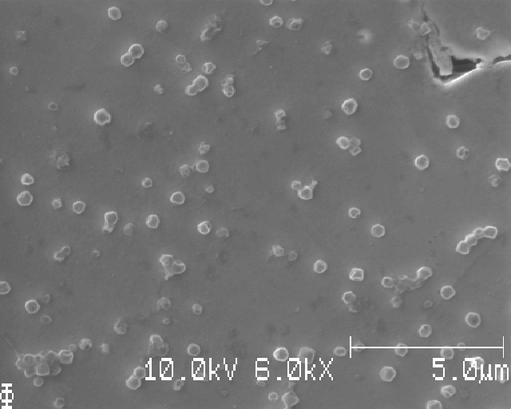
S26:

Slide 13
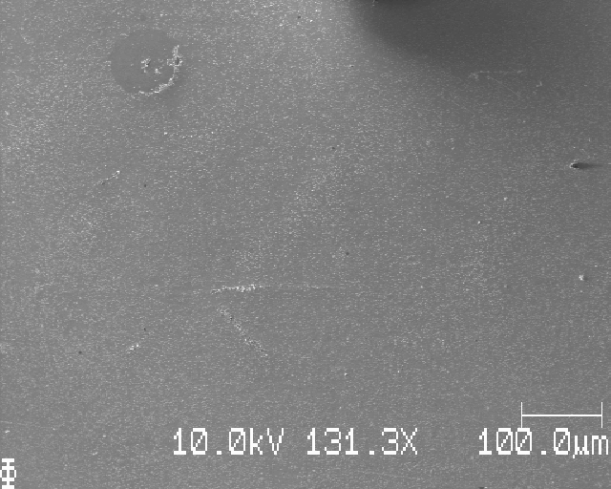
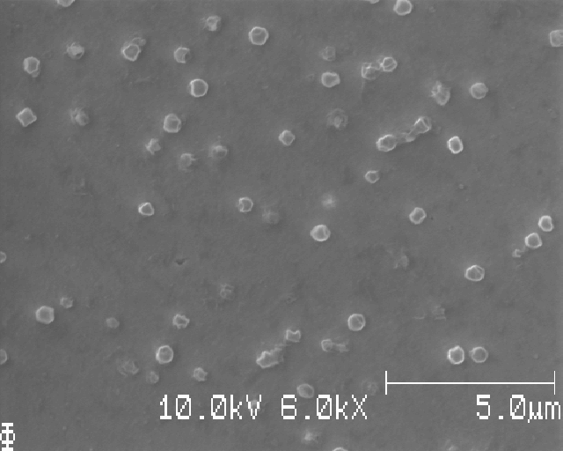
S26:

Slide 14
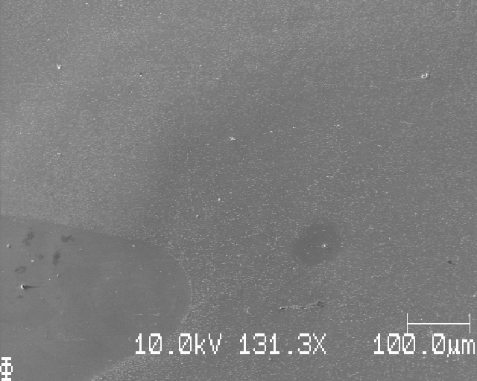
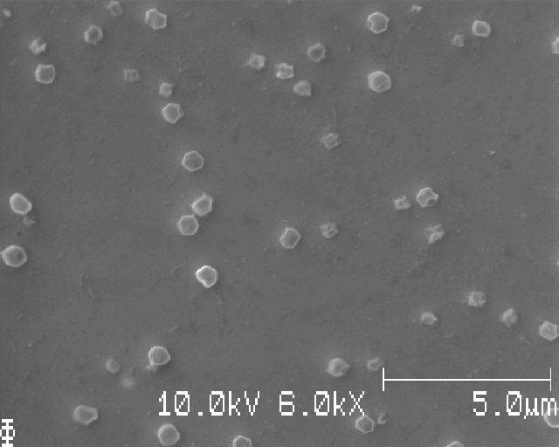
S26:

Slide 15
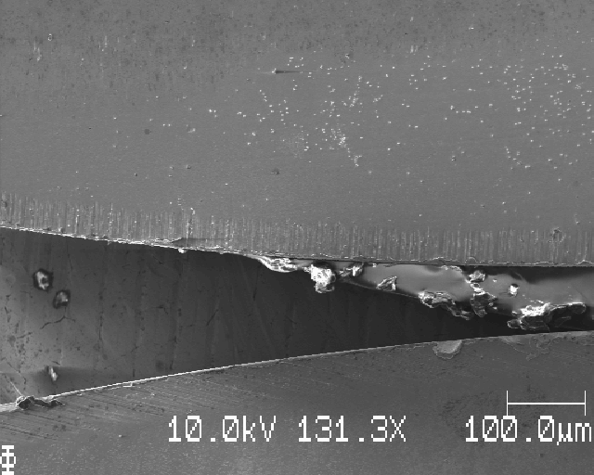
S26: bottom edge of sample

Slide 16
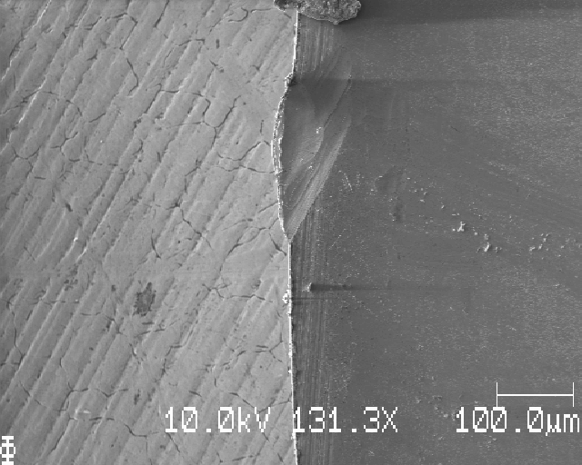
S26: right edge, moving right dx=1mm

Slide 17
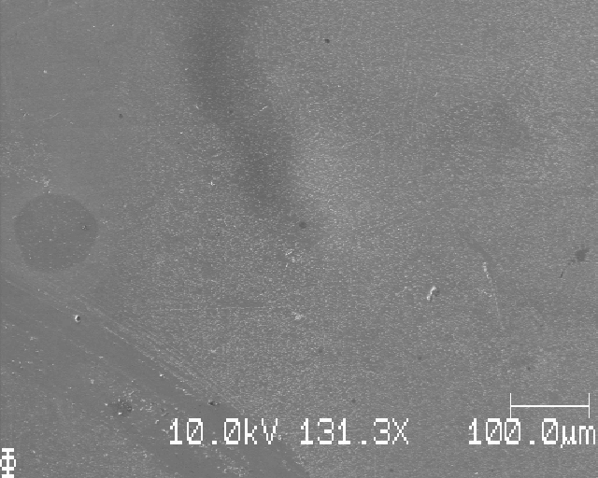
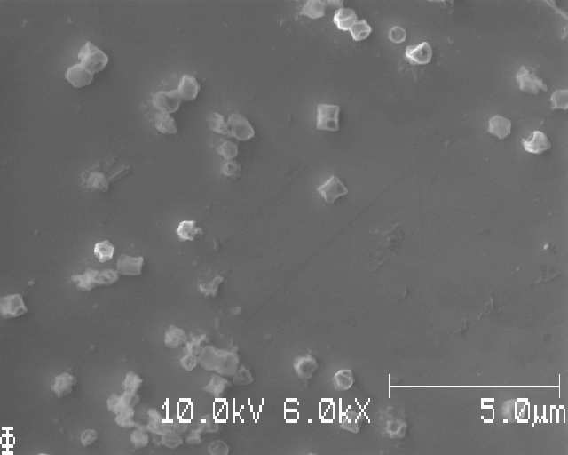
S26:

Slide 18
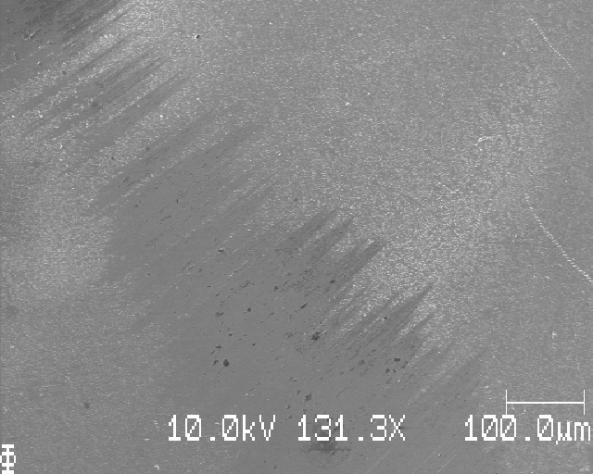
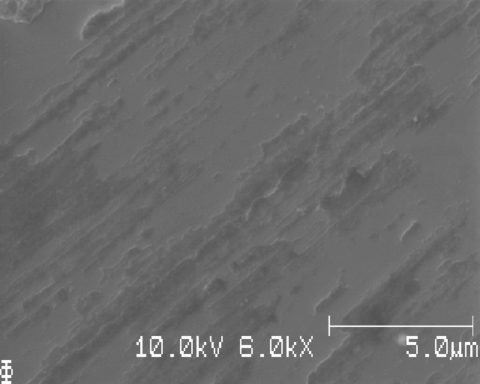
S26:

Slide 19
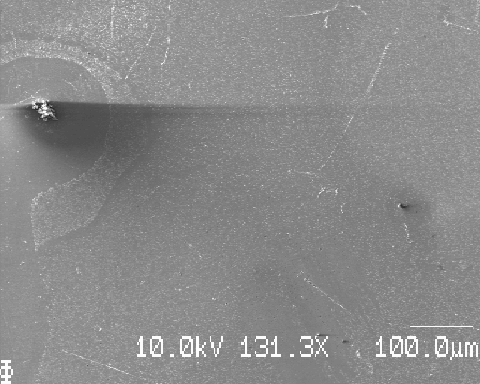
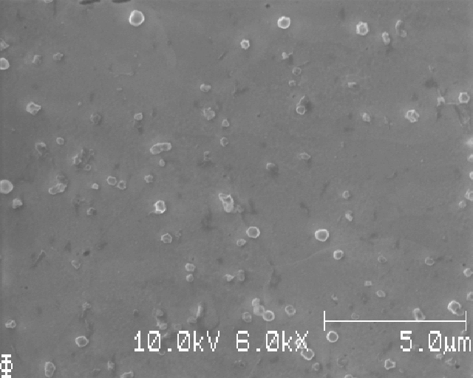
S26:

Slide 20
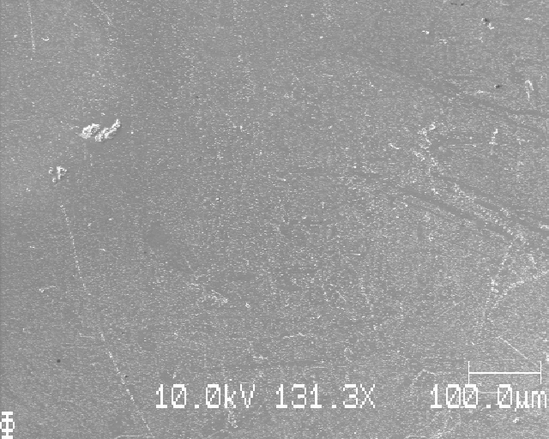
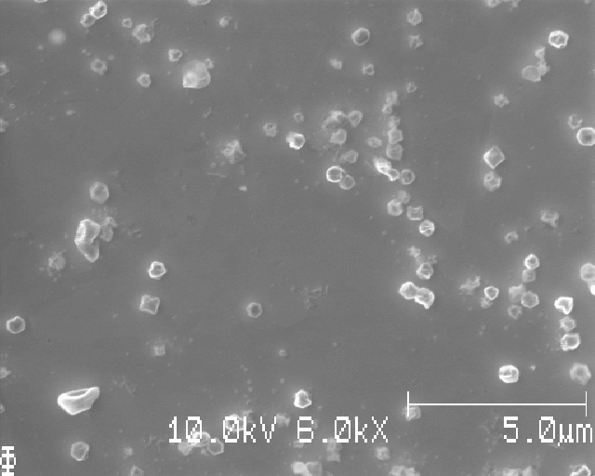
S26:

Slide 21
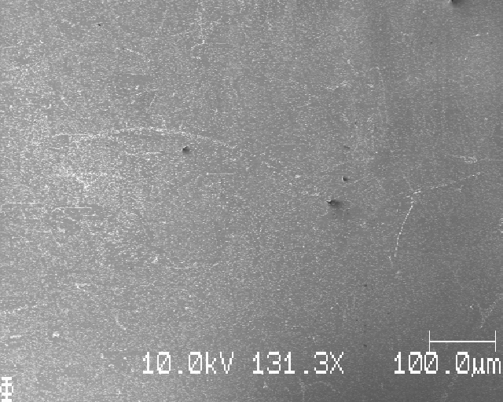
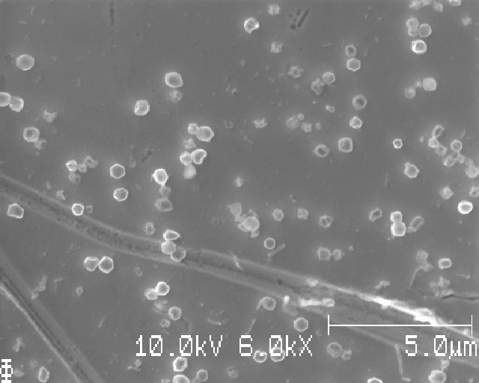
S26:

Slide 22
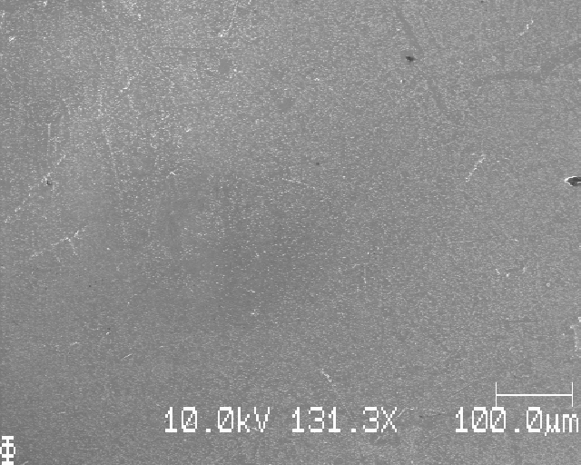
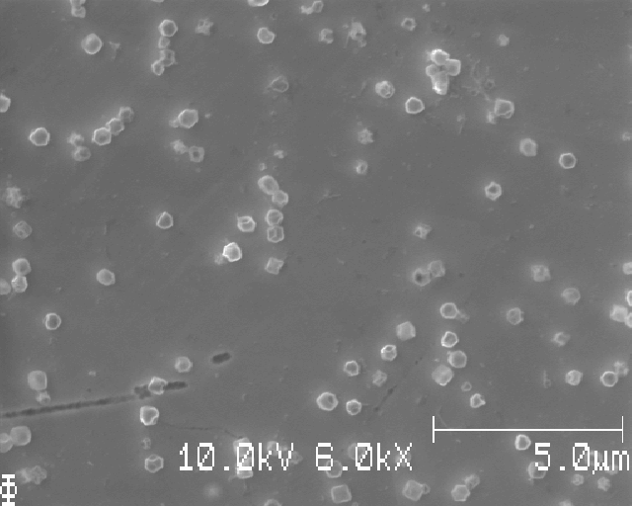
S26:

Slide 23
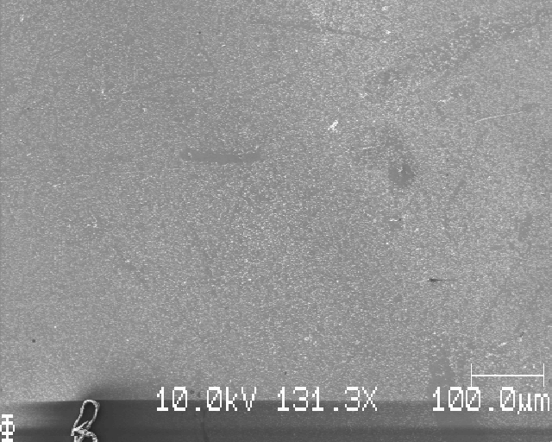
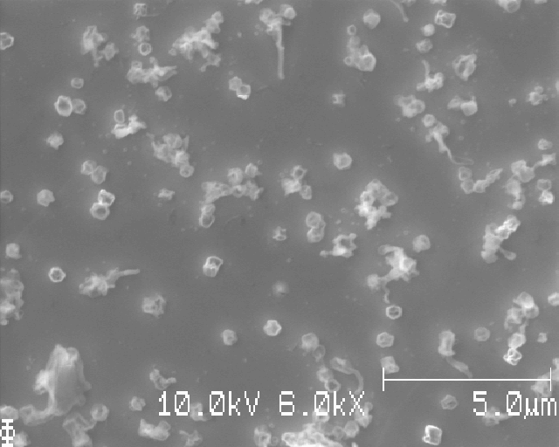
S26:

Slide 24
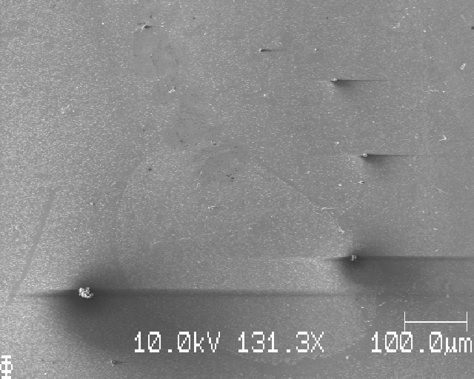
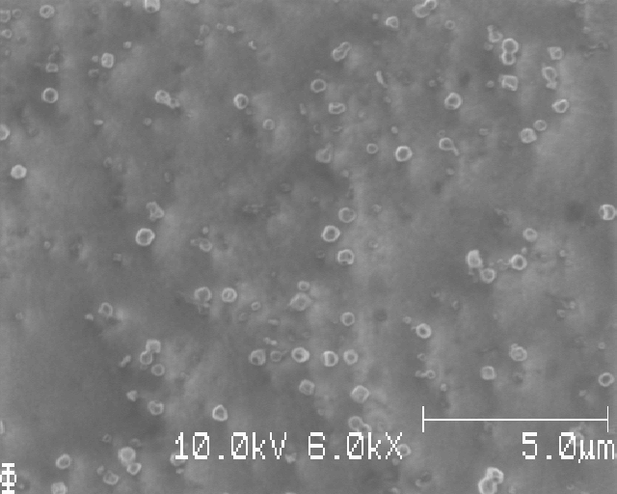
S26:

Slide 25
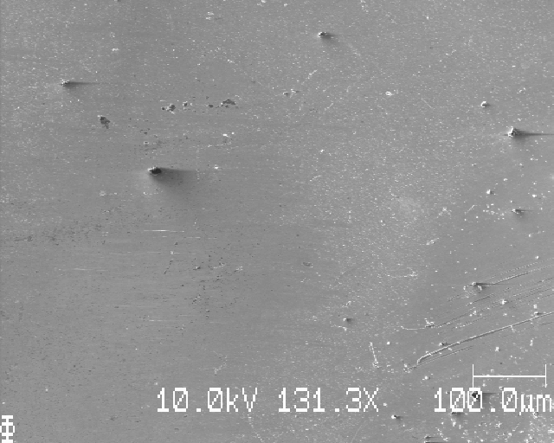
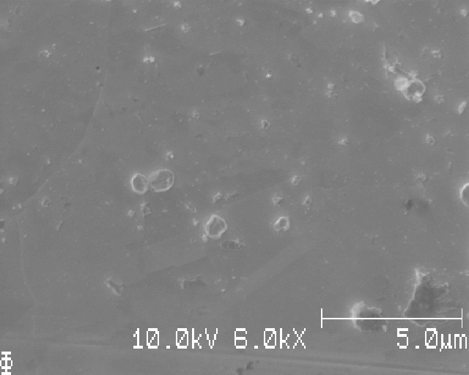
S26:

Slide 26
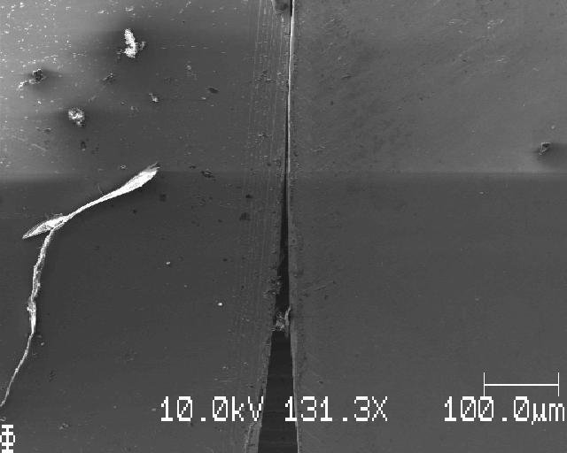
S26: right edge

Slide 27
S26: grid SEM images squares, dx=dy=1000mu

Slide 28
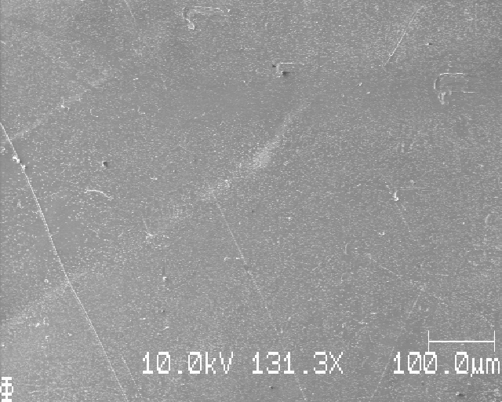
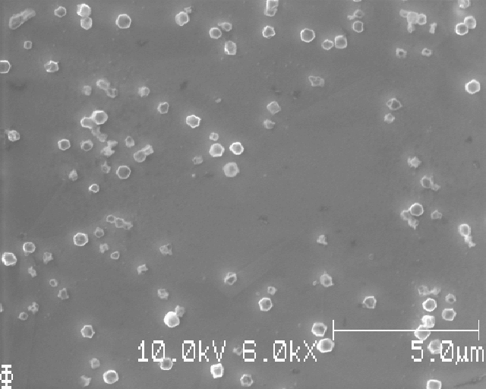
Position 1 of 16
Notes:
Löpande nummer: 1

Slide 29
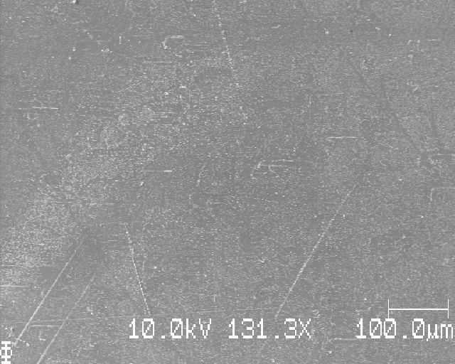
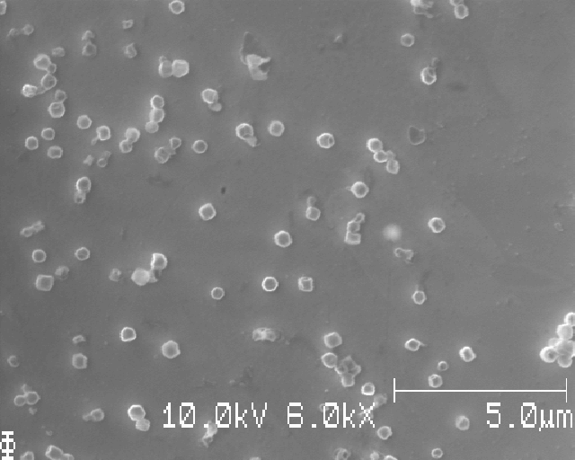
Position 2 of 16
Notes:
Löpande nummer: 2

Slide 30
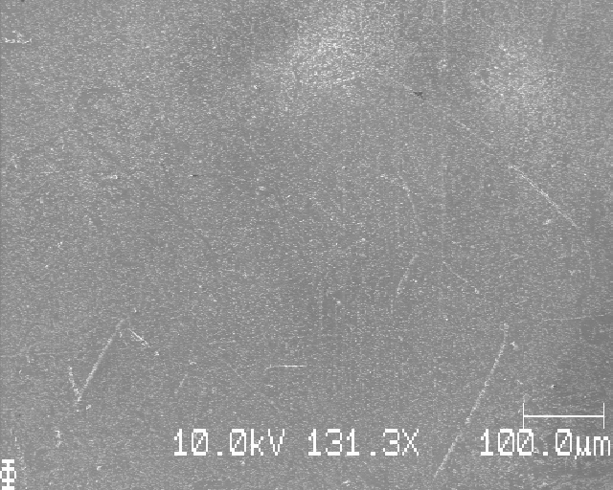
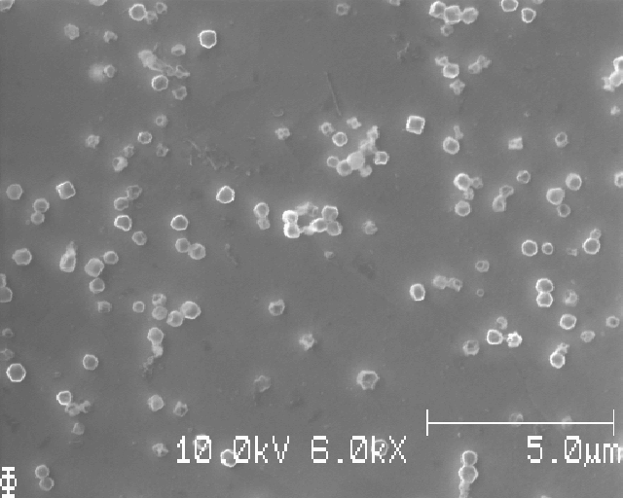
Position 3 of 16
Notes:
Löpande nummer: 3

Slide 31
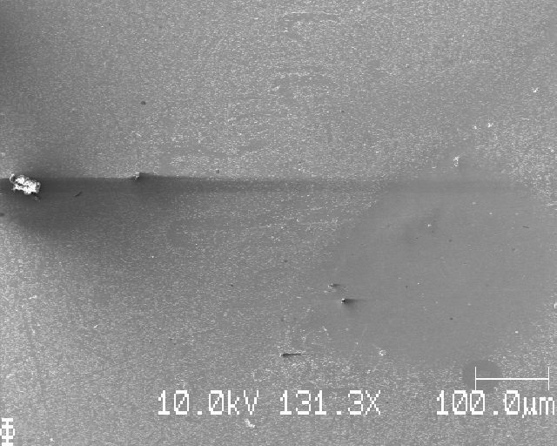
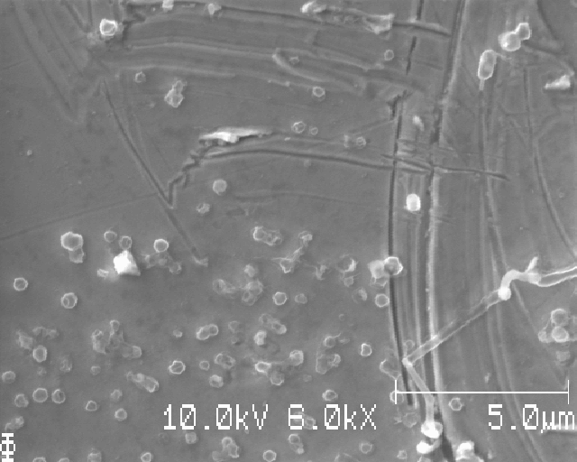
Position 4 of 16
Notes:
Löpande nummer: 4

Slide 32
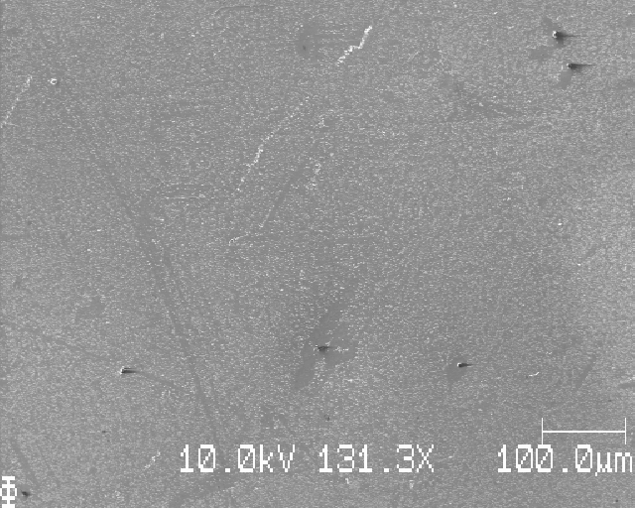
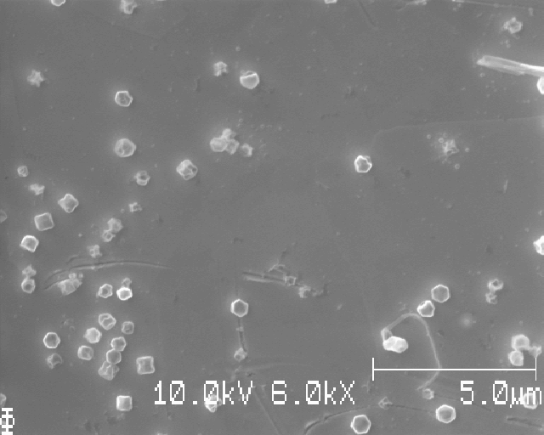
Position 8 of 16
Notes:
Löpande nummer: 5

Slide 33


Position 7 of 16
Notes:
Löpande nummer: 6

Slide 34


Position 6 of 16
Notes:
Löpande nummer: 7

Slide 35


Position 5 of 16
Notes:
Löpande nummer: 8

Slide 36


Position 9 of 16
Notes:
Löpande nummer: 9

Slide 37


Position 10 of 16
Notes:
Löpande nummer: 10

Slide 38


Position 11 of 16
Notes:
Löpande nummer: 11

Slide 39


Position 12 of 16
Notes:
Löpande nummer: 12

Slide 40


Position 16 of 16
Notes:
Löpande nummer: 13

Slide 41


Position 15 of 16
Notes:
Löpande nummer: 14

Slide 42


Position 14 of 16
Notes:
Löpande nummer: 15

Slide 43


Position 13 of 16
Notes:
Löpande nummer: 16 (slut)

Slide 44


Extra, close to each position (avoid bad segmentation): Position 4 of 16

Slide 45


Extra, close to each position (avoid bad segmentation): Position 8 of 16

Slide 46


Extra, close to each position (avoid bad segmentation): Position 10 of 16

Slide 47


Extra, close to each position (avoid bad segmentation): Position 12 of 16

Slide 48


Extra, close to each position (avoid bad segmentation): Position 6 of 16

Slide 49
S26: learning points
Looks pretty good!
If the next sample looks as even w.r.t. the Li deposition, then this is the way to do it!
However, still some unevenness, but given that you take 4x4 images and averages them, I’d say that variation is fine

Slide 50
(next sample)

Slide 51
S27_Icell_t1800_C0010_J01_12mmLi

Slide 52

S27: top edge, moving down dy=1mm

Slide 53


S27:

Slide 54

S27:

Slide 55


S27:

Slide 56


S27:

Slide 57


S27:

Slide 58


S27:

Slide 59


S27:

Slide 60


S27:

Slide 61


S27:

Slide 62

S27: bottom edge of sample

Slide 63
S27: learning points
The Li deposition looks more or less as even as in S26
However, the Li looks corroded (all of it), which is curious
Still, a larger Li (12mm in diameter) seems to induce much more even Li deposition than a smaller (5 mm in diameter) Li

Slide 64
(next sample)

Slide 65
S28_Icell_t1800_C0010_J01_12mmLiPolished

Slide 66

S28: top edge, moving down dy=1mm

Slide 67


S28:

Slide 68


S28:

Slide 69


S28:

Slide 70


S28:

Slide 71


S28:

Slide 72


S28:

Slide 73


S28:

Slide 74


S28:

Slide 75


S28:

Slide 76

S28: bottom edge

Slide 77
S28: learning points
Reasonable even Li, but still a bit uneven in places
Polishing of Li by scraping of the top oxide layer with a scalpel did not give rise to obvious preferred Li deposition – in other words, it seems to have worked fine
One difference between this and S26 is that there are very little if any corroded Li particles – we only see nice crystalline particles here

Slide 78
(next sample)

Slide 79
S29_Icell_t1800_C0010_J01_12mmLiPolished

Slide 80

S29: top edge, moving down dy=1mm

Slide 81


S29:

Slide 82


S29:

Slide 83


S29:

Slide 84



S29:

Slide 85


S29:

Slide 86


S29:

Slide 87



S29:

Slide 88


S29:

Slide 89


S29:

Slide 90
S29: bottom edge of sample

Slide 91
S29: learning points
lorem

Slide 92

Josef’s 1mm Li sample

Slide 93

Beam damage in the middle(?): right side

Slide 94

Left side

Slide 95


Slide 96

They bubble when imaged

Slide 97



Slide 98


Same place as previous slide

Slide 99

Raster scan in SEM →grid-like black dots on something reacts

Slide 100




